Slide 1
Homework 1

Slide 2
Homework 1
Target: Compiler for C
Deadline: 3/26(四) 23:59
DEMO: 暫定3/27 (demo時間另行公布)
Upload your file to moodle
A zipped file(.rar, .zip, .7z, …) contain your source code and readme
Filename: StudentID
Ex: F74012345.rar
Post your problems on moodle

Slide 3
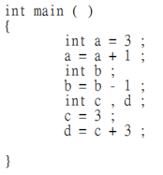
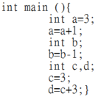
Homework 1
Environment: Linux: g++ 4.8.2版
不允許使用3rd-party函式庫，必須使用C/C++(包含C++11)
完成基本功能 50%
解釋程式碼 30%
無空白分Token 20% (需符合C語言格式)
原
無空白

Slide 4
Homework 1
Input file:
main.c
Output file:
token.txt

Slide 5
Lexical Analyzer(Lexer)
Source
Code
Token
List
Lexer

Slide 6
Token
Keywords
int char float double return if else while break for print
Operators
= ! + - * / == != < > <= >= && ||
Special Symbols
[ ] ( ) { } ; ,
Identifier
[a-zA-Z_][a-zA-Z0-9_]*
Number
[0-9]+([.][0-9]+)?
Char
‘[.|\n|\t| ]’
Ex. ‘a’、’\n’、’ ’
Comment(no need to print)
//
Error
int 1e2s ;

Slide 7
Lexer Output
Output file format
Line xx :
xx – Line number
<yyy> : zzz
yyy – Category(Keyword、Operator、Special Symbol、Identifier、Char、Number、Error)
zzz – token
Ex.
Line 1 :
<Keyword> : int
<Identifier> : main
<Special> : (
<Special> : )

Slide 8
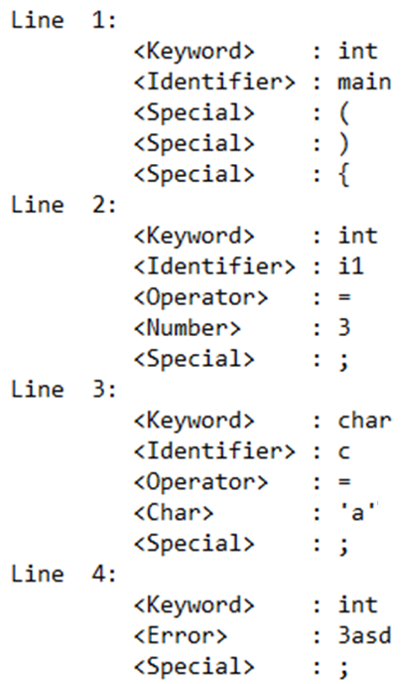
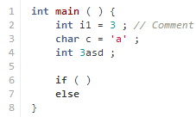
Lexer Output Example
token.txt

